Slide 1
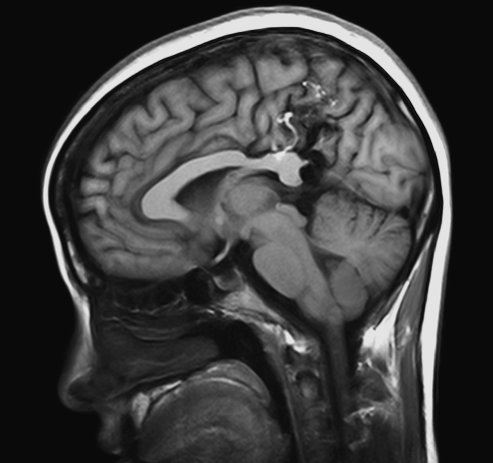

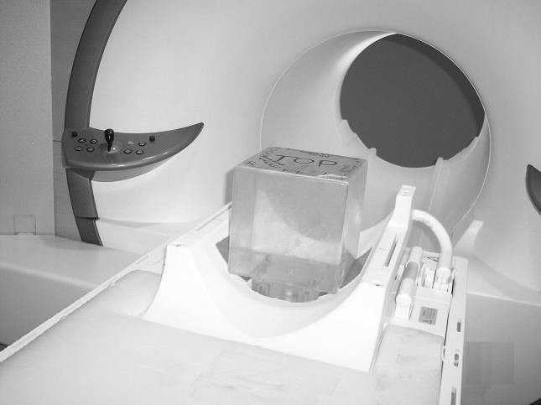
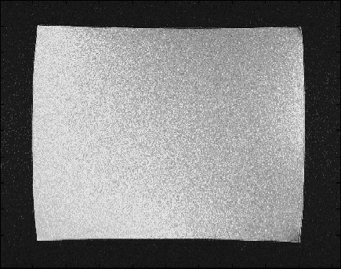
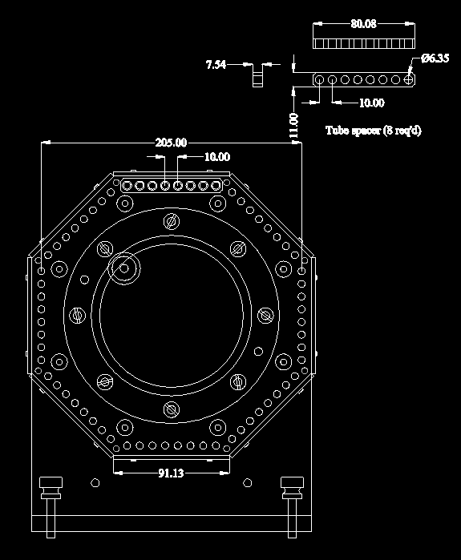
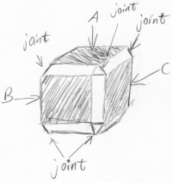
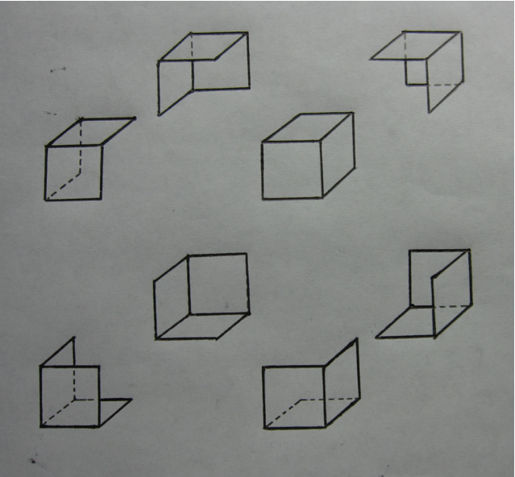
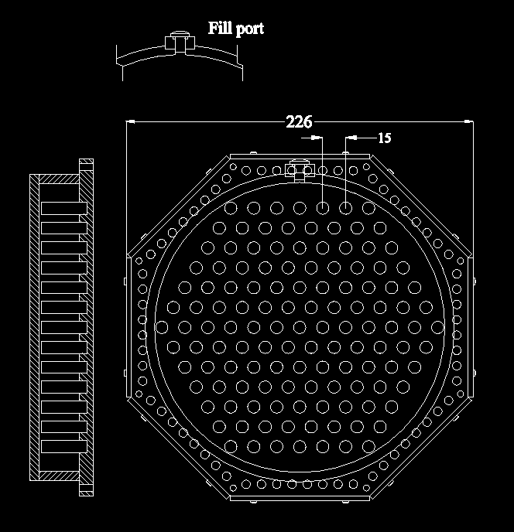
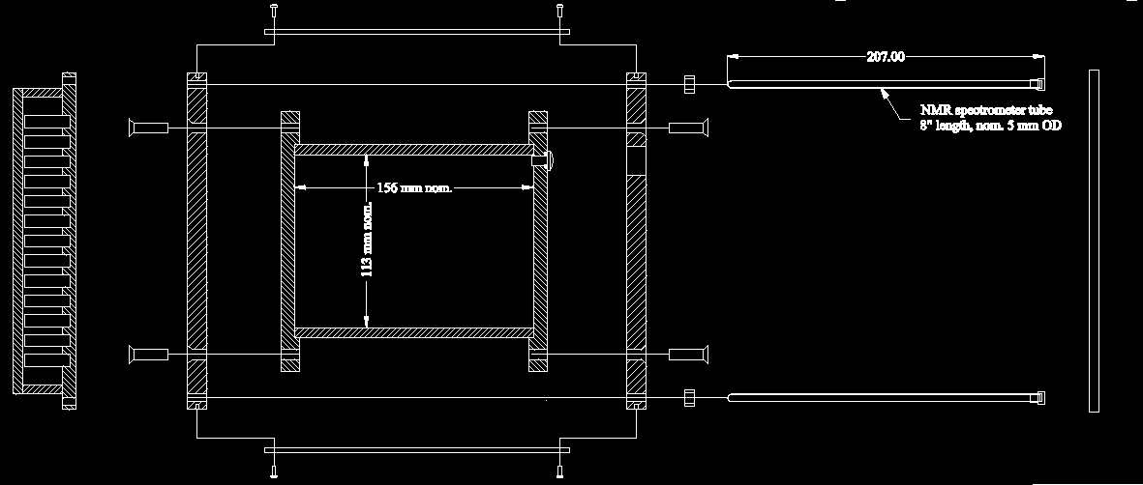
PHANTOM DESIGN FOR DISTORTION
CORRECTION OF MR IMAGES
R. Cai, K. E. Schubert, R. Schulte
Original 1.5T Phantom
Magnetic resonance imaging (MRI) provides an excellent modality for distinguishing different tissues in the human body, which is essential for medical applications. When MRI is used for stereotactic treatment planning, its geometric accuracy is crucial. Previous studies have been conducted to correct the distortion caused by nonlinearity of the MRI scanner’s magnetic gradient fields by imaging a cubic phantom [1], [2] and defining distortion correction functions based on the distorted appearance its surfaces. Correct mathematical handling of the distortion correction function required that the cube was centered about the magnetic isocenter, which is defined as the common center of the three magnetic gradient fields and is not very accurately known. New 3Tesla MRI systems have a larger bore, making the previous phantom design impractically small for probing the field nonlinearity in the periphery of the bore, as the phantom cannot be scaled up due to constraints related to weight and cost of manufacturing. We are introducing a new phantom design using a different approach, which can be built to a larger size, improves accuracy of distortion characterization and reduces cost.
Cubic phantom for 1.5T MRI Scanner
Scan of cubic phantom showing distortion in 1.5T MRI.
Initial Design
Current Design
The original phantom design, a 16-cm oil-filled cube, could not be scaled up due to weight and manufacturing constraints. Our first modification was to look at changing the material to FR-4 since it is rigid, very flat, and could be submerged for short periods of time to permit scanning the solid liquid interface in an MRI machine. Since most of the distortion is visible only in the corners, this was rapidly replaced by 8 corners of a virtual cube, which could be connected by a rigid frame. The weight of a tank to submerge either of these designs to allow scanning was prohibitive, requiring a complete redesign.
The new phantom is shaped to fit the inner volume of the MRI head coil to a maximum degree, so as to achieve the maximum quality of signal and largest distortion. The phantom is an octagonal prism with 205mm between opposite sides. Each face of the octagonal prism is composed of 8 high precision NMR tubes that are 5mm in outer diameter and 205 mm in length. These tubes are filled with copper sulfate solution to generate a strong signal in an MRI scanner. The tubes are placed parallel to the magnetic field so they will cause less susceptibility distortion [3], and thus provide more accurate information on the gradient field. In the center of the phantom is a large water tank to help intensify the signals generated by the tubes. At one end of the phantom is a cylindrical tank filled with copper sulfate, with a number of small solid cylinders in a hexagonal pattern that are connecting the two surfaces of the tank. These cylinders are used to maintain the long-term accuracy of the two surfaces, making sure they won’t deform, and are also aligned to the field to minimize their effect on the field. The data generated from 64 tubes mounted on the sides are designed to give us x and y axis distortion information, and the end tank is designed to provide z-axis distortion data, allowing a complete 3-D distortion correction with a relatively small amount of data.

Slide 2
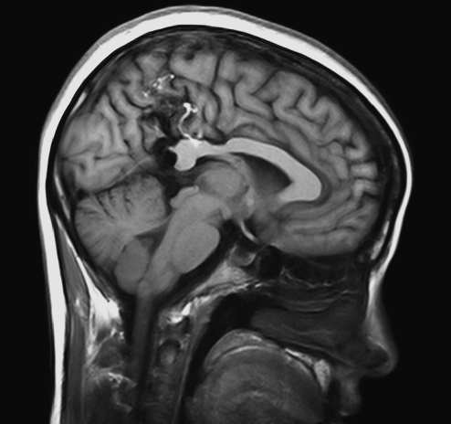

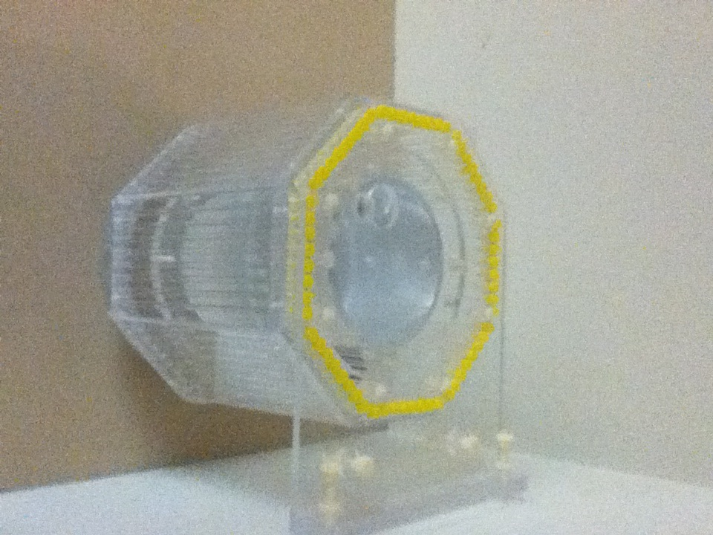
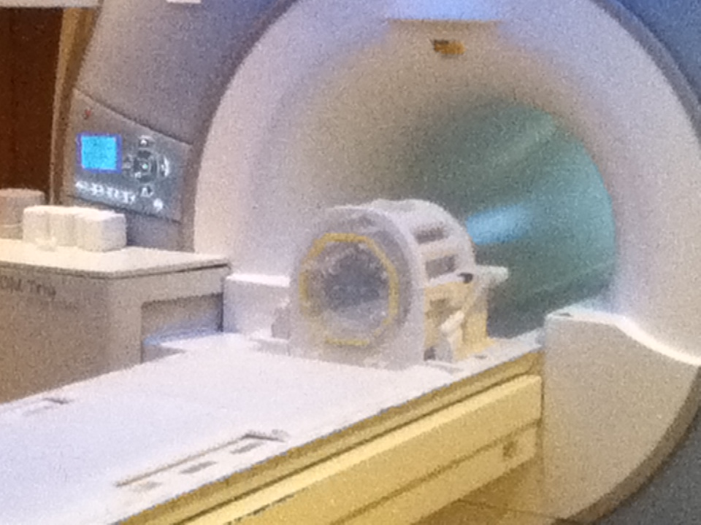
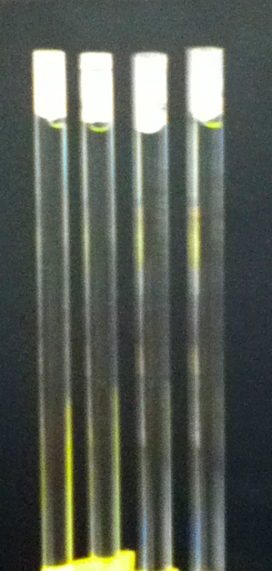
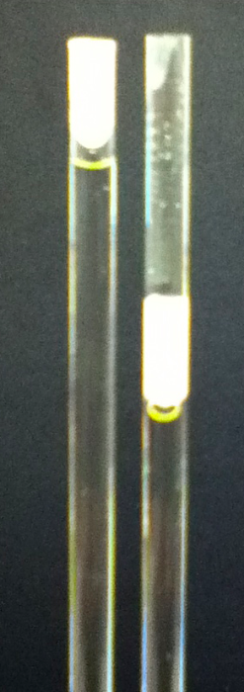
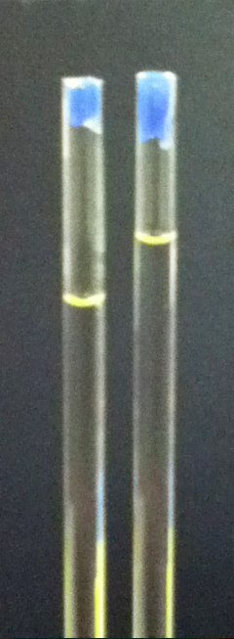
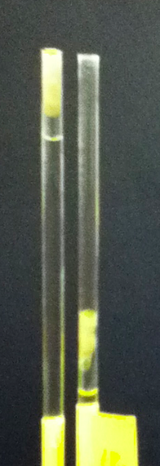
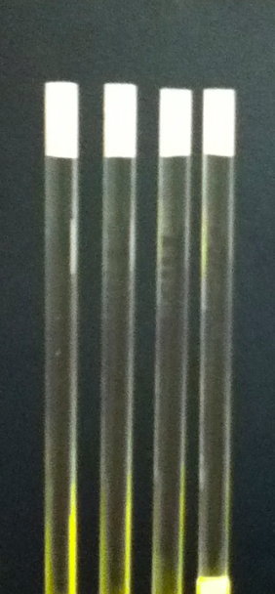
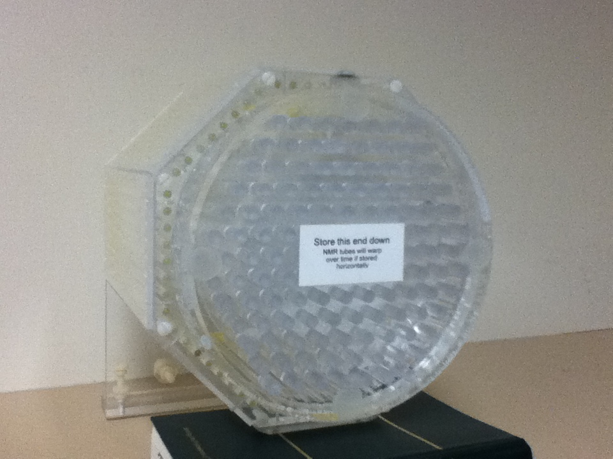
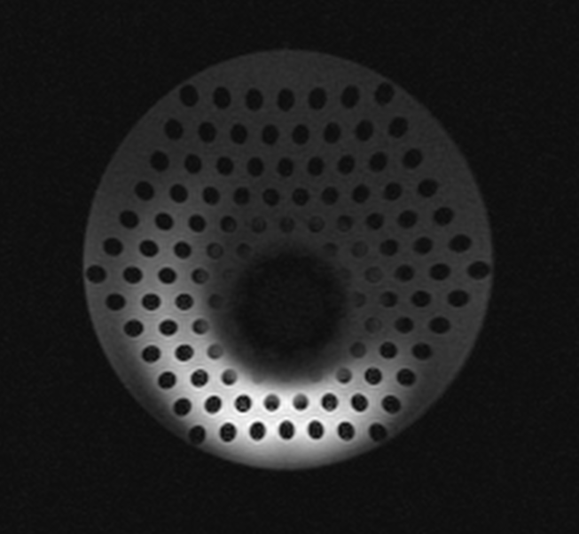
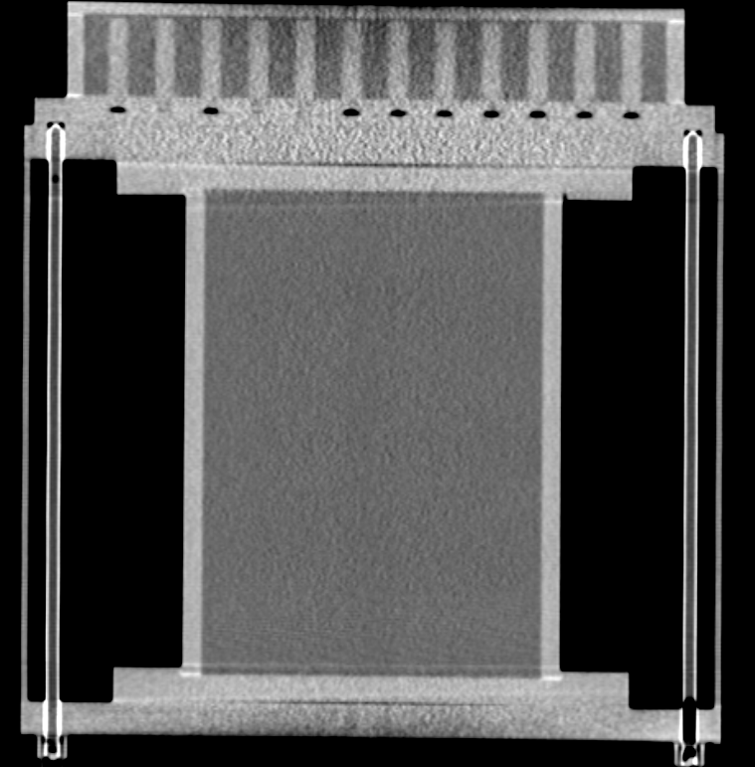
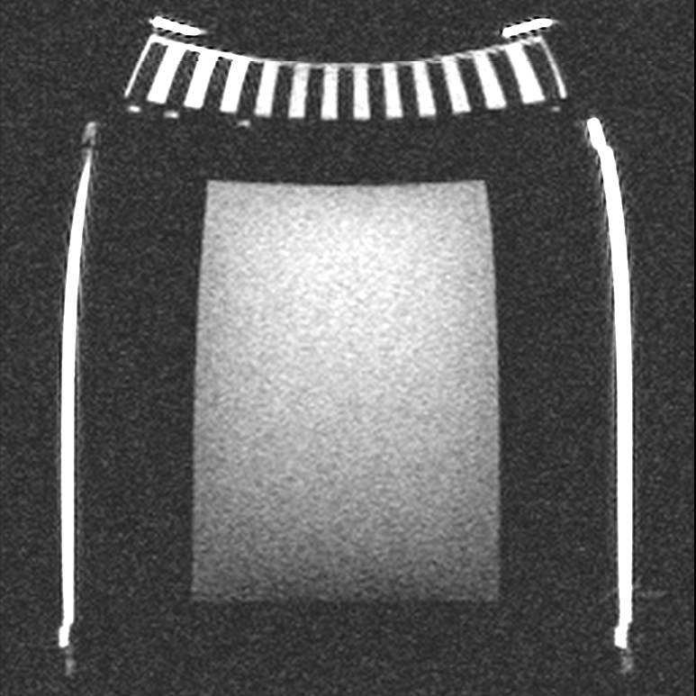
PHANTOM DESIGN FOR DISTORTION
CORRECTION OF MR IMAGES
R. Cai, K. E. Schubert, R. Schulte
Installation and Use
The new phantom is designed to rest in the head coil of a 3T MRI scanner. It has a back plate with several leveling screws to align the phantom in the head coil using the laser alignment system. This alignment is aided by alignment marks on the outside of the phantom. The phantom is then moved into the MRI scanner, and its center is placed as close to the isocenter as possible. While it is not required to be centered, centering does improve the performance. A quick alignment scan is used to ensure the phantom is in the best location possible. When this is done the scan is taken and processed using distortion detection and correction software, which is not subject of the present presentation.
Sealing NMR Tubes
Our original idea for sealing the NMR tubes was to use paraffin wax, either with or without a silicon seal. Paraffin was heated and a liquid drop was then added to the tube as a seal , but had an uneven bottom caused by the rapid solidifying of the wax, when it came in contact with the copper sulfate. Additionally, it tended to trap air bubbles, which made the end very hard to work with in the images. Worst yet, after a few weeks the liquid level in the tubes started to drop. We decided to compare three potential alternatives: machinable wax, water weld, and silicon sealer. As the images on the right show, the silicon was far and away the best. There was no leakage lost, and since the setup time was slower on the liquid side it ended up being almost completely flat. Every feature was met, and it was also the most cost effective solution.
1
2
3
4
5
Paraffin wax at top with floatable silicon at bottom
Paraffin wax only
Machinable wax
Water weld
Silicon
Distortion Detection
The CT image of the phantom on the left below shows how accurately it was created. Below and to the right is the 3T MR image of the same phantom, that was placed in a head coil. The plastic and glass do not show on the MR image, but the copper sulfate and water are provide a strong signal. Distortion is clearly visible, particularly in the upper corners. Note the NMR tubes appear bent inward, and the end tank is bowed outwards. The
The water tank in the middle also has some distortion although less than the outer NMR tubes. The smaller amount of distortion in the central water tank demonstrates the need for a larger phantom than the original cubic phantom, which had the approximate size of the central water tank. The left picture above shows the end tank, which contains regularly spaced cylinders. The right image shows the MR image of the end tank, which is clearly distorted in all dimensions. The black “hole” in the central part of the end tank is the effect of a distortion in longitudinal (z) direction. It appears is in the lower half of the image because the magnetic scanner isocenter is in the lower half of the phantom. Furthermore, the spacing cylinders appear as ellipses rather than circles, because the straight image plane cuts across the distorted cylinders at an angle.
Conclusion
References
The new distortion phantom performs with excellently now that the NMR tubes are sealed with silicon. It is large enough to detect the distortion of the gradient coils and allow for the correction of the image. Both the NMR tubes and the end tank show good resolution of the distortion features. It would be advantagous to have a second end tank on the other side. Additionally, since the phantom is sensitive to rotations, a rotational alignment unit will improve the ability to automatically detect and correct the images. We are currently designing a three axis rotational stage that can be custom fit to a scanner and head coil.
The authors graciously acknowledge the support of the National Institute of Health under Grant No. 1R01EB013118-01.
[1] S. Langlois, M. Desvignes, J.M. Constans, and M. Revenu, MRI
Geometric Distortion: A Simple Approach to Correcting the Effects of
Non-linear Gradient Fields, J. Magn. Reson. Imaging, vol. 9,
pp. 821-831, 1999.
[2] T. Lee, K. Schubert, R. Schulte, Software-Based Algorithm for Modeling
and Correction of Gradient Nonlinearity Distortions in Magnetic
Resonance Imaging, IAENG Transactions on Electrical and Electronics
Engineering, vol. I, 2008
[3] J. F. Schenck, “The Role of Magnetic Susceptibilty In Magnetic
Resonance Imaging: MRI Magnetic Compatibility of the First And
Second Kind”, Medical Physics, vol. 23, iss 6, 1996, pp. 815–850.
[4] R. Cai, K. Schubert, R. Schulte, Computational Algorithm for Estimating
the Gradient Isocenter of an MRI Scanner. Proceedings of the
International Conference on Scientific Computing, 2012, accepted.

